Slide 1
Converting casual users into members through data.
Presented by: Paul Carmody
Last updated: Dec 10th, 2022

Slide 2
Agenda
Objective (What are we talking about?)
What the data says
Conclusion
Final recommendations
Appendix

Slide 3
Objective
Identify any patterns in the data that might help convert causal users into members.
We looked specifically at patterns in time, duration and location of use.
Casual users – Those who use the service on an ad-hoc basis
Members – Those who have an active subscription to Cyclistic.

Slide 4
What the data says
Casual users are mostly tourists and members live in the city.

Slide 5
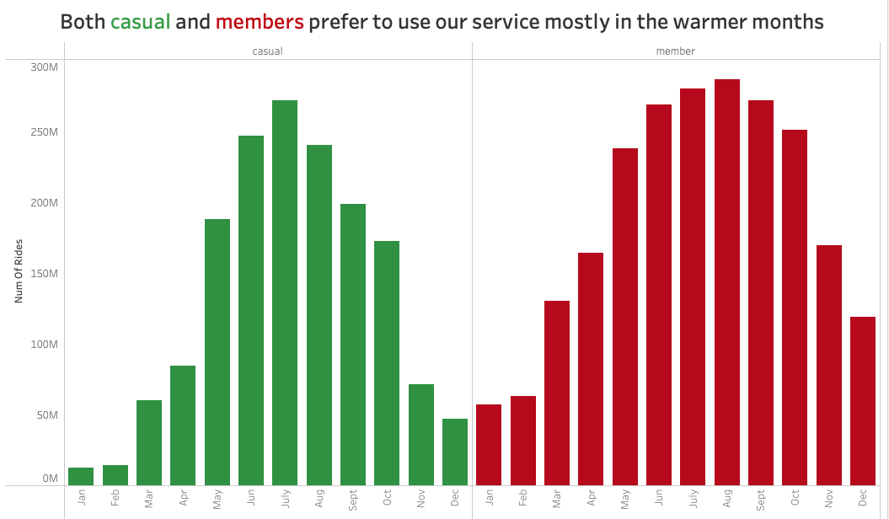
Time patterns
Both types of users enjoy using the service when it is nice outside

Slide 6
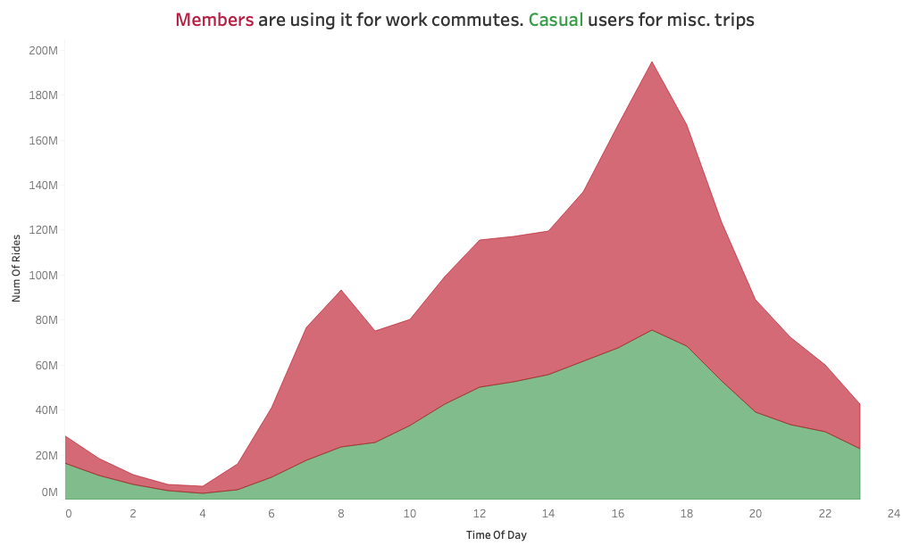
Time patterns
Both types of users enjoy using the service when it is nice outside
Members are locals as they use it for commutes. Causal users for tourist trips.
Work commutes
Steady increase in rides through out day

Slide 7
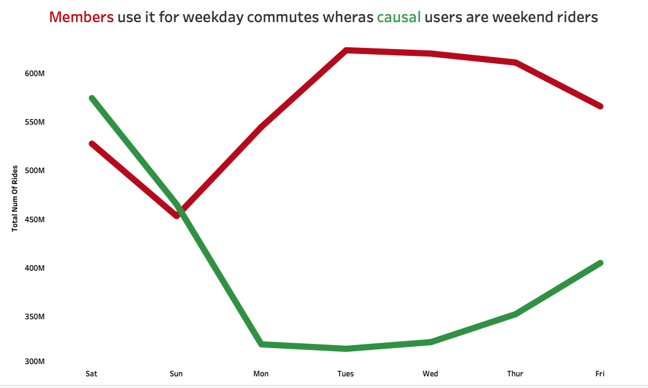
Time patterns
Both types of users enjoy using the service when it is nice outside
Members are locals as they use it for commutes. Causal users for tourist trips
Members use the service during weekdays and causal users are weekend users.
Casual users have less use for our service during the weekdays

Slide 8
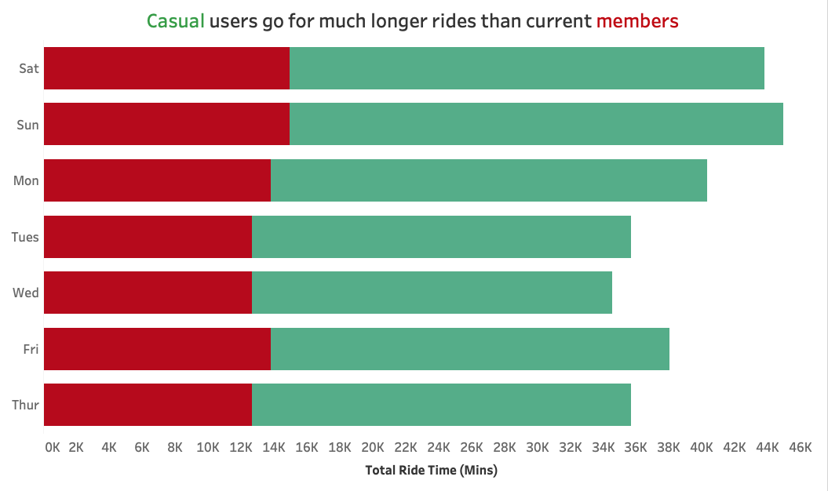
Duration
Casual members go for much longer trips. Members enjoy short trips.

Slide 9
Duration
Casual members go for much longer trips. Members enjoy short trips.
59% of trips are member trips

Slide 10
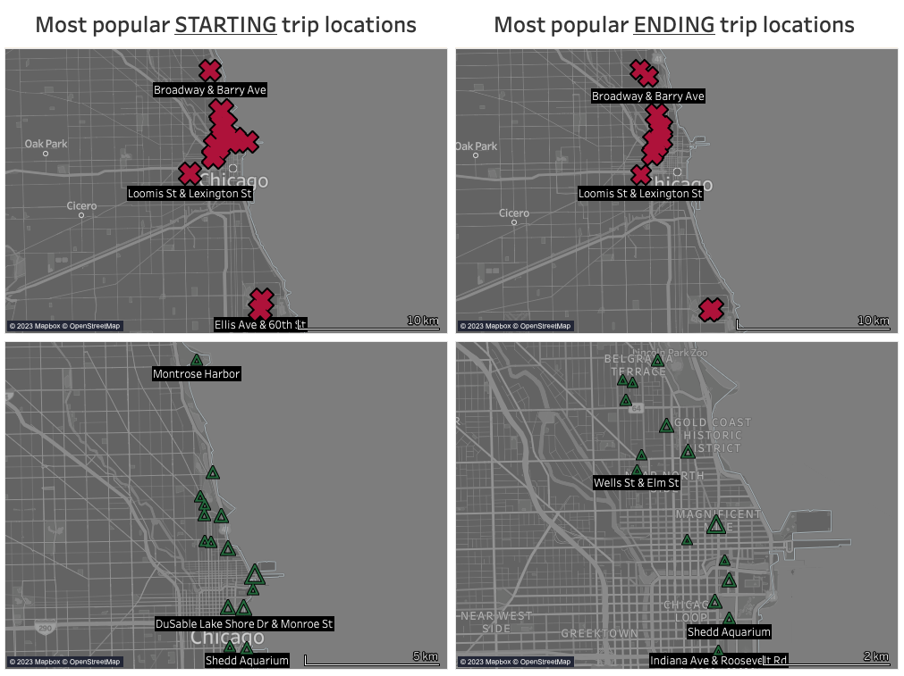
Location
All users start and end around both city centres

Slide 11
Location
All users start and end around both city centres
Casual users are starting and ending journeys beside key tourist sites

Slide 12
Location
All users start and end around both city centres
Casual users are starting and ending journeys beside key tourist sites
Members use a wider range of central stations for their journeys

Slide 13
Conclusion
Both users enjoy using the bikes in the warmer months
Members like to use them as a commute to and from work/college
Weekends are popular for both user types but especially for casual users.
Weekdays are not popular for casual users
Casual riders go on longer journeys
Members use the bikes more often.
Both users prefer to use the bikes that are stationed around the city hubs and members use a wider range of central stations
Casual members start and end journeys near tourist spots

Slide 14
Recommendations
Tourist passes
Create short-term membership such as a weekend pass to encourage casual users to use the service more often. Longer tourist passes could also be available pending demand ie Summer Pass.
Social media campaign
Promote the ease of getting around the city centre in summer months to maximize both users using the service more
User discounts in select stores
Stores located near tourist spots could offer discounts for members. This would promote greater membership and also offer additional advertising
Data was limited to one dataset and to a limited time range. If a wider range of data was included, we could explore more patterns and possible revenue streams
Further data analysis
1
2
3
4

Slide 15
Appendix
The full detailed report can be accessed here
SQL code
Link to dataset
Link to interactive graphs

